Slide 1
Dual-Feature Warping-based Motion Model Estimation (ICCV2015)
Shiwei Li, Lu Yuan, Jian Sun, Long Quan

Slide 2
Motivation (limitation)
1. Misalignments due to the lack of reliable keypoints
2. Distortion artifact induced by flexible warps due to insufficient corresponding information

Slide 3
Motivation (solution)
1. Dual-features (keypoints & lines)
2. Line preserving flexible warp

Slide 4






Dual-features (keypoints & lines)
Parameterization
Energy function
Endpoints:
$${\hat{p}}^{0}, {\hat{p}}^{1}$$
$$\hat{ℳ}=\underset{ℳ}{argmin}{(\sum_{i}{d^{2}\left({\hat{p}}_{i},p_{i}^{′}\right)+\sum_{j}{d^{2}(\hat{I_{j}},I_{j}^{′})}})}$$
Line transformation:
$$I^{′}=ℳ∘I$$
$${\hat{p}}_{i}=ℳ∘p_{i}$$
$${\hat{I}}_{j}=ℳ∘I_{j}$$
Line to line distance:
$$d\left(I,I^{′}\right)=\sqrt{d^{2}\left({\hat{p}}^{0},I^{′}\right)+d^{2}({\hat{p}}^{1},I′)}$$

Slide 5
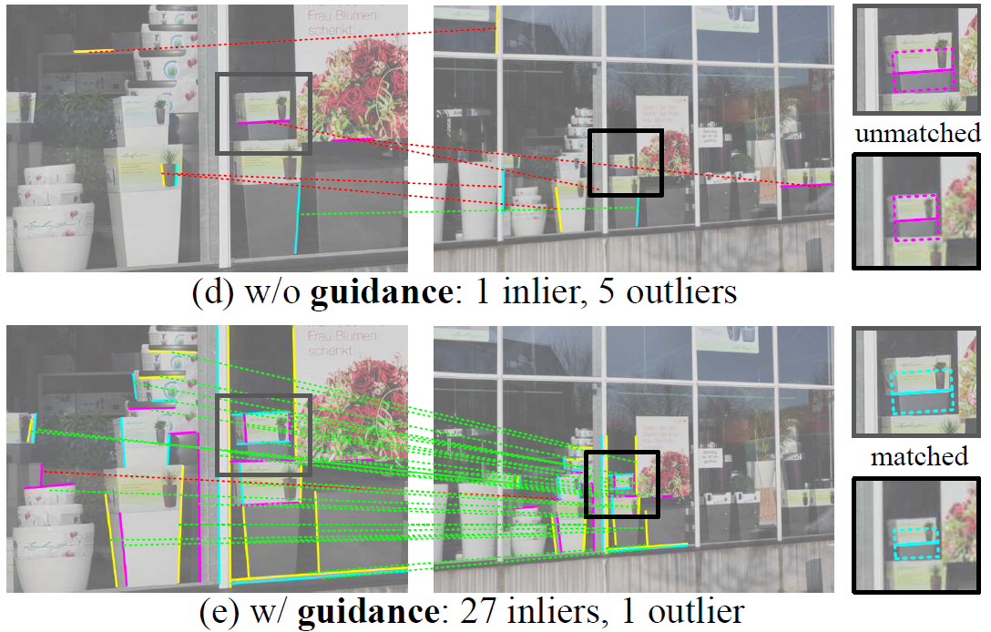
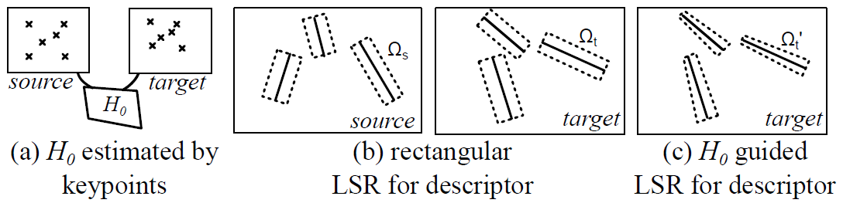
Dual-features (keypoints & lines)
Line detection and matching
1. Detection: EDLine [1]
2. Matching: LSR (Line Supporting Region) & MSLD [2]
[1] C. Akinlar and C. Topal. Edlines: A real-time line segment detector with a false detection control. Pattern Recognition Letters., 32(13):1633–1642, 2011.
[2] Z. Wang, F. Wu, and Z. Hu. Msld: A robust descriptor for line matching. Pattern Recognition Letters., 42(5):941–953, 2009.

Slide 6




Warping-based Motion Model
Dual-feature Homography Estimation
$$min\left(\sum_{i}{{\left\|p_{i}^{′}−{\hat{p}}_{i}\right\|}^{2}}+\sum_{j}{\frac{{\left|{I_{i}^{′}}^{T}{\hat{p}}_{j}^{0}\right|}^{2}+{\left|{I_{i}^{′}}^{T}{\hat{p}}_{j}^{1}\right|}^{2}}{a^{′2}+b^{′2}}}\right)⁡$$
1. Geometric Distance:
2. Algebraic Distance:
$$\hat{H}=\underset{H}{argmin}\left(\sum_{i}{{\left\|p_{i}^{′}×Hp_{i}\right\|}^{2}}+\sum_{j}{{\left\|{I_{j}^{′}}^{T}Hp_{j}^{0,1}\right\|}^{2}}\right)$$
= $\underset{H}{argmin}\left(\sum_{i}{{\left\|A_{i}h\right\|}^{2}}+\sum_{j}{{\left\|B_{j}h\right\|}^{2}}\right)$
$$A_{i}=\left[\begin{matrix}\begin{matrix}x_{i} & y_{i} & 1\end{matrix} & \begin{matrix}0 & 0 & 0\end{matrix} & \begin{matrix}−x_{i}^{′}x_{i} & −x_{i}^{′}y_{i} & −x_{i}^{′}\end{matrix} \\ \begin{matrix}0 & 0 & 0\end{matrix} & \begin{matrix}x_{i} & y_{i} & 1\end{matrix} & \begin{matrix}−y_{i}^{′}x_{i} & −y_{i}^{′}y_{i} & −y_{i}^{′}\end{matrix}\end{matrix}\right]$$
$$B_{i}=λ_{i}\left[\begin{matrix}\begin{matrix}a_{j}^{′}u_{j}^{0} & a_{j}^{′}v_{j}^{0} & a_{j}^{′}\end{matrix} & \begin{matrix}b_{j}^{′}u_{j}^{0} & b_{j}^{′}v_{j}^{0} & b_{j}^{′}\end{matrix} & \begin{matrix}c_{j}^{′}u_{j}^{0} & c_{j}^{′}u_{j}^{0} & c_{j}^{′}\end{matrix} \\ \begin{matrix}a_{j}^{′}u_{j}^{1} & a_{j}^{′}v_{j}^{1} & a_{j}^{′}\end{matrix} & \begin{matrix}b_{j}^{′}u_{j}^{1} & b_{j}^{′}v_{j}^{1} & b_{j}^{′}\end{matrix} & \begin{matrix}c_{j}^{′}u_{j}^{1} & c_{j}^{′}v_{j}^{1} & c_{j}^{′}\end{matrix}\end{matrix}\right]$$

Slide 7


Warping-based Motion Model
Dual-feature Homography Estimation
1. Balancing
Algebraic residual:
$\left\|A_{i}h\right\|$ $\sim d(Hp_{i},p_{i}^{′})∙w_{i}$
(i.e., the geometric distance multiplying $w_{i}$)
$\left\|B_{i}h\right\|$ $=λ_{i}{I_{j}^{′}}^{T}Hp_{j}^{0,1}\sim d\left({\hat{p}}_{j}^{0,1},I_{j}^{′}\right)∙w_{j}^{0,1}⇒ λ_{i}=\frac{1}{\sqrt{{a_{j}^{′}}^{2}+{b_{j}^{′}}^{2}}}$

Slide 8
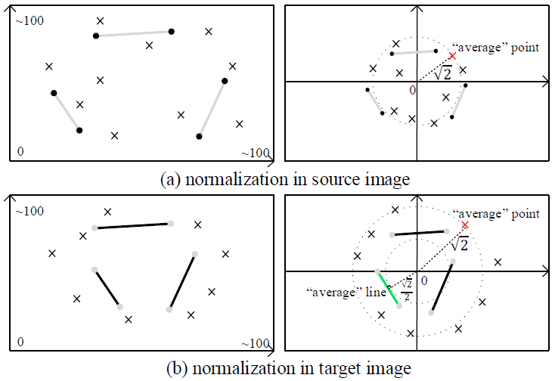

Warping-based Motion Model
Dual-feature Homography Estimation
2. Normalization (Hartley’s normalization)
2.1 Source image: (x, y, u, v) only points and endpoints
Points & Endpoints： “average point” is (1, 1, 1)
2.2 Target image: (x’, y’, a’, b’, c’) points and lines
Point: “average point” is (1, 1, 1)
Line: $\left[\frac{a^{′}}{c^{′}},\frac{b^{′}}{c^{′}},1\right]\sim 1$ “average distance” to origin is $\frac{1}{\sqrt{{\left(\frac{a^{′}}{c^{′}}\right)}^{2}+{\left(\frac{b^{′}}{c^{′}}\right)}^{2}}}=\frac{1}{\sqrt{2}}$

Slide 9


Warping-based Motion Model
Dual-feature Homography Estimation
3. Robust Estimation （RANSAC ）
Fitting error for point:
$$d\left(\hat{p},p′\right)=\sqrt{{\left\|p^{′}−\hat{p}\right\|}^{2}}$$
$$d\left(\hat{I},I′\right)=\sqrt{\frac{{\left|I^{′T}∙{\hat{p}}^{0}\right|}^{2}+{\left|I^{′T}∙{\hat{p}}^{1}\right|}^{2}}{{a^{′}}^{2}+{b^{′}}^{2}}}$$
Fitting error for line:
The inliers of dual-feature will be further used for local warp estimation

Slide 10
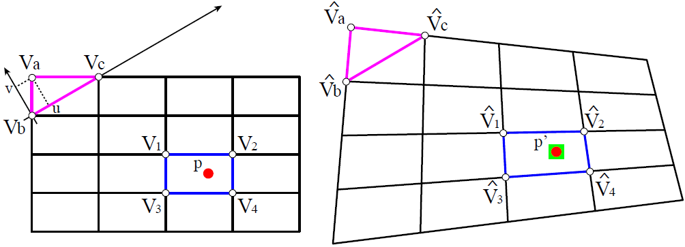

Warping-based Motion Model
Dual-feature Local Warps
Content-preserving warp （CPW）： Data term + Smoothness term
$$E_{point}\left(V\right)=\sum_{i}{{\left\|V_{p_{i}}w_{p_{i}}−p_{i}^{′}\right\|}^{2}}$$
$$E_{smoothness}\left(V\right)=\sum_{i}{{\left\|V_{a}−(V_{b}+u\left(V_{c}−V_{b}\right)+vR_{90}(V_{c}−V_{b}))p_{i}^{′}\right\|}^{2}}$$

Slide 11
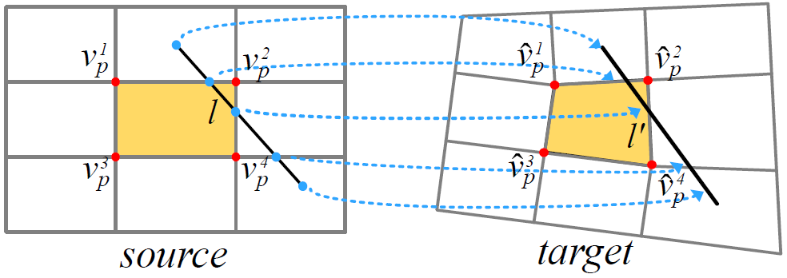

Warping-based Motion Model
Dual-feature Local Warps
$$E_{line}\left(V\right)=\sum_{i,k}{{\left\|{I_{j}^{′}}^{T}∙V_{p_{k}}w_{p_{k}}/\left(\sqrt{{a_{j}^{′}}^{2}+{b_{j}^{′}}^{2}}\right)\right\|}^{2}}$$
Line term:

Slide 12
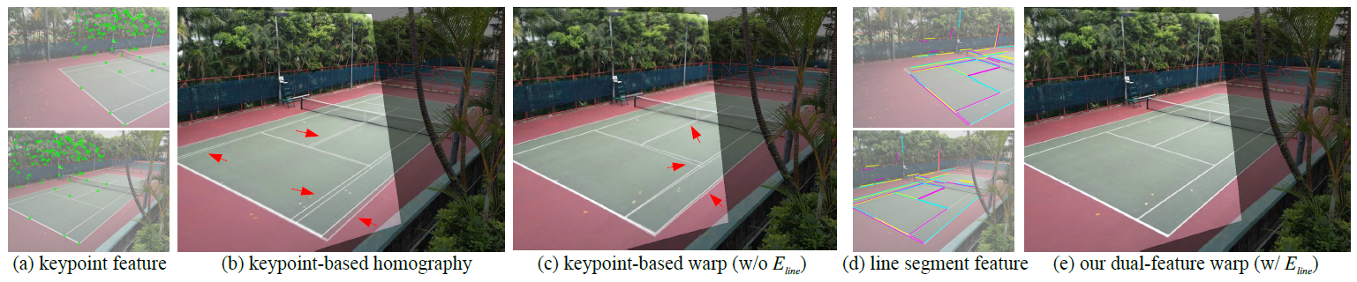
Warping-based Motion Model
Dual-feature Local Warps
Total energy:
$$E\left(V\right)=E_{point}\left(V\right)+E_{line}\left(V\right)+αE_{smoothness}(V)$$

Slide 13
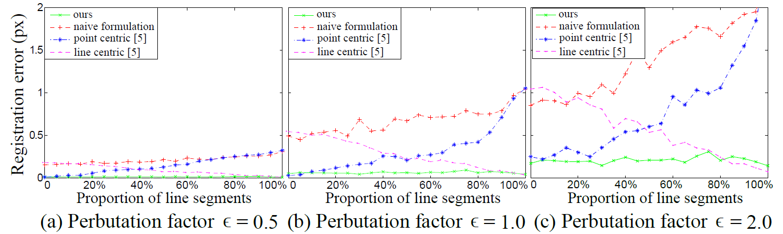
Quantitative Evaluation
Numerical stability
Synthesized data: perturbation on point and line features

Slide 14
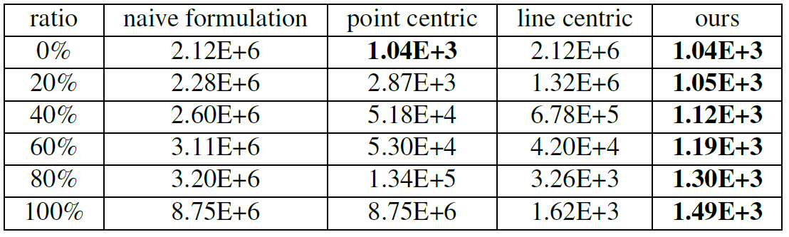
Quantitative Evaluation
Numerical stability
Condition number of the matrix for SVD decomposition

Slide 15
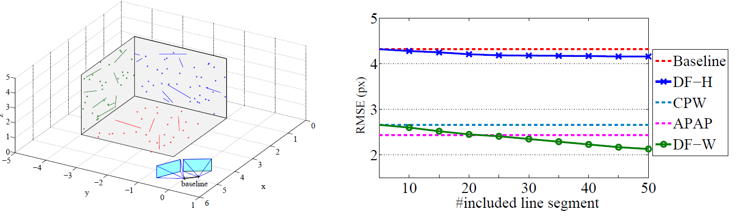
Quantitative Evaluation
Translational camera motion
Synthesized data (points & lines) + translational cameras

Slide 16
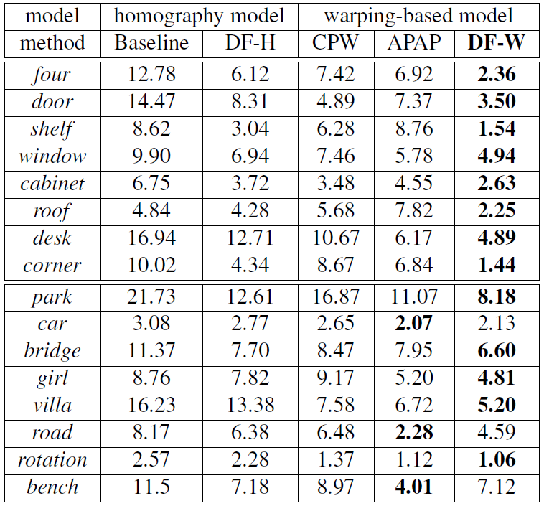
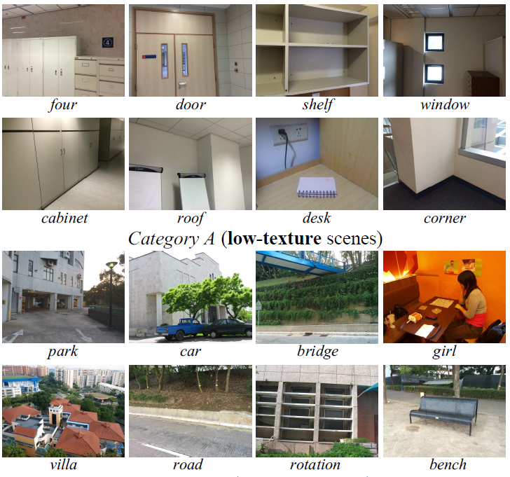

Quantitative Evaluation
$$EMSE\left(I_{i},I_{j}\right)=\sqrt{\frac{1}{N}\sum_{π}{{\left(1−NCC\left(x_{i},x_{j}\right)\right)}^{2}}}$$
Real Images

Slide 17
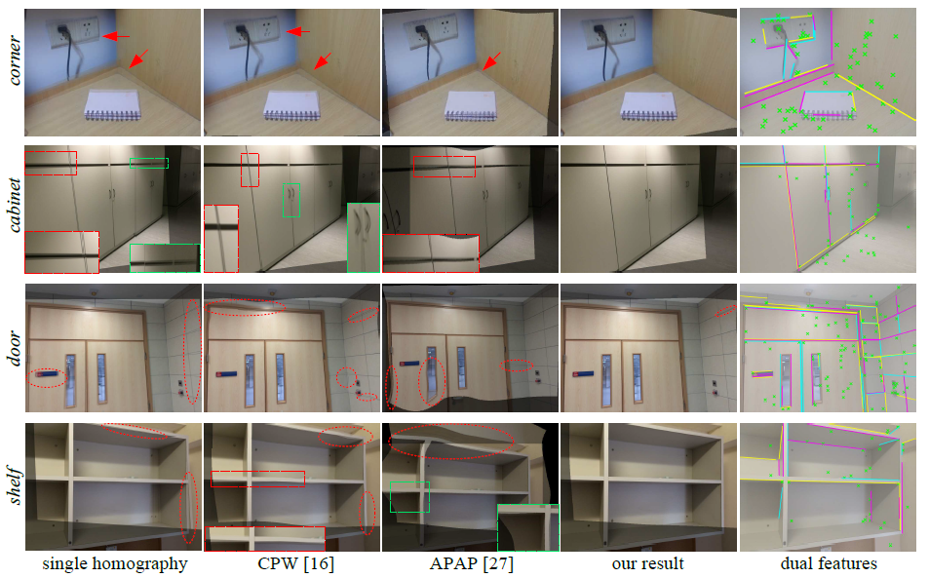
Qualitative Evaluation
Image Stitching (indoor environments)

Slide 18
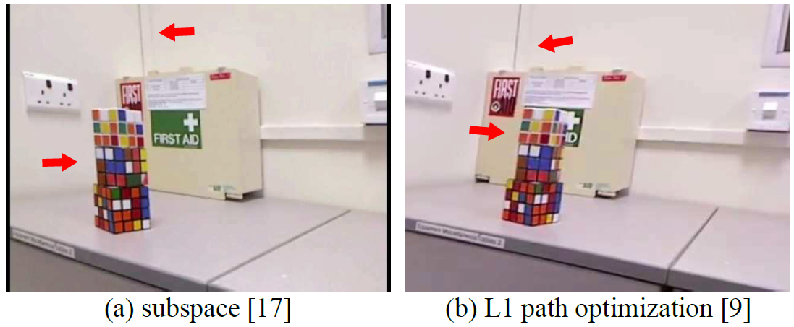
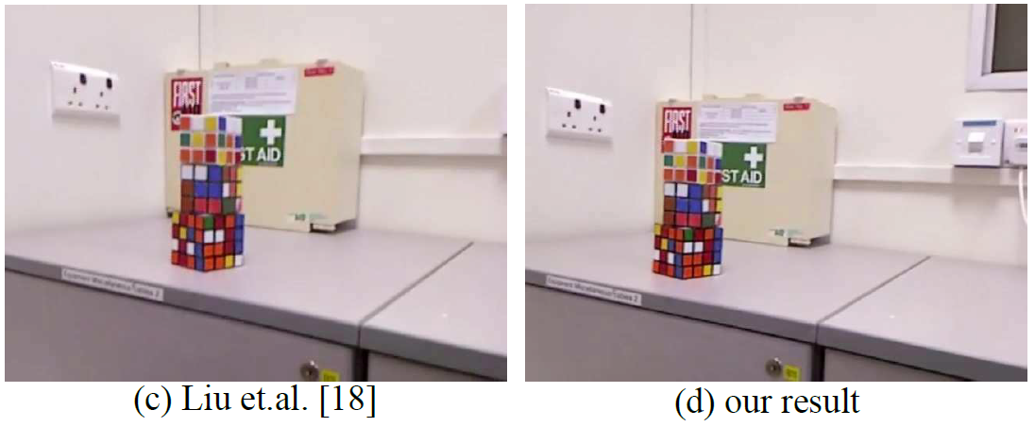
Qualitative Evaluation
Video Stabilization

